Slide 1
Madrid 13 December 2019

Slide 2
¿Qué es eso de cuantizar modelos?
Madrid
Alexander Gonzalez
AI Software Engineer – Plain Concepts
@alexndrglez

Slide 4
AGENDA

Slide 5
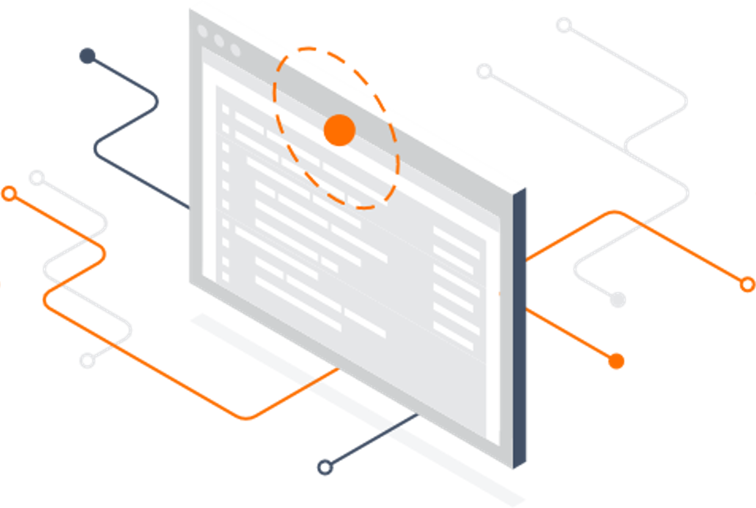
¿Que es la Cuantización?
Tensorflow Lite (Post-training quantization
Quantization-aware training
Model Optimization
Requisitos TF Lite
Coral Dev Board
Dev Board and Accelerator
MDT Flash
Características
¿Que es TPU?

Slide 6
Demo 1
Glyphs Paper Dataset
Mobilenet V2
Training/Test
Conversión TFLite
Compilación Edge TPU
Inferencia Coral Dev Board TPU Runtime
Demo 2
CI/CD Raspberry Pi (IoT Edge)

Slide 7
Why do we care?

Slide 8
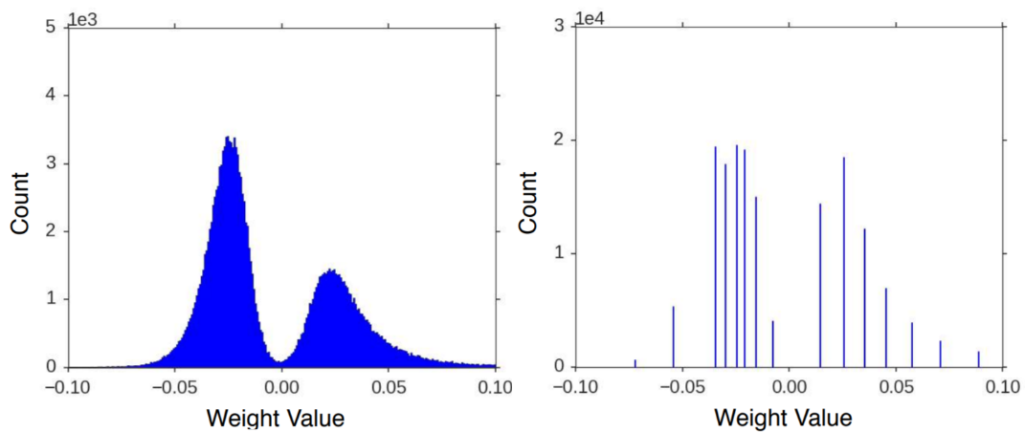
How it works?

Slide 9

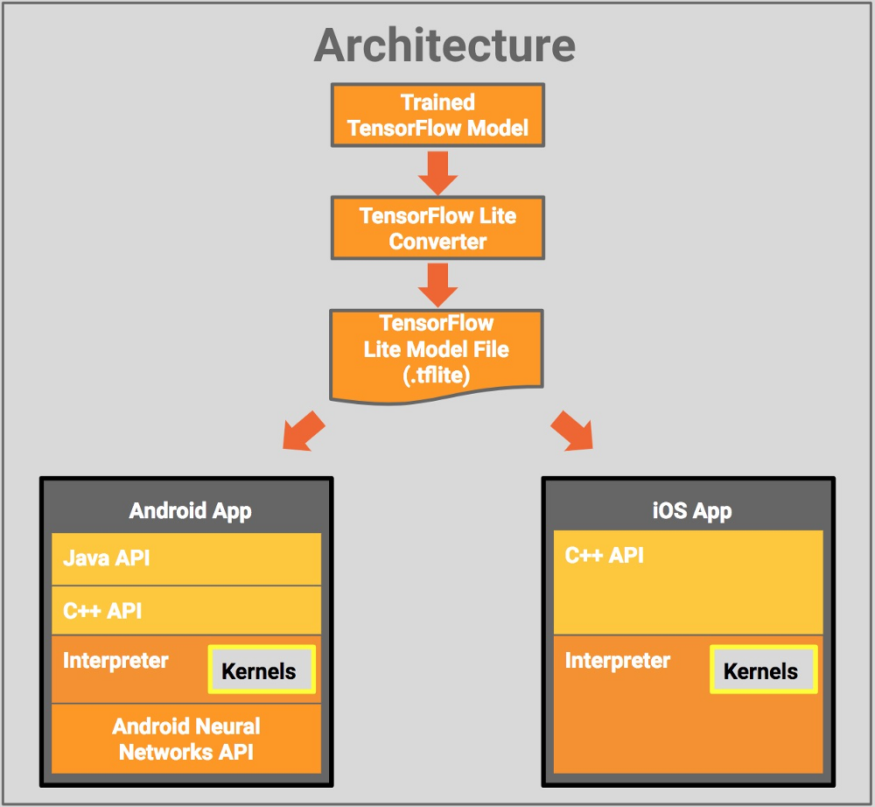
TensorFlow Lite is TensorFlow’s lightweight solution for mobile and embedded devices.
It lets you run machine-learned models on mobile devices with low latency, so you can take advantage of them to do classification, regression or anything else you might want without necessarily incurring a round trip to a server.

Slide 10
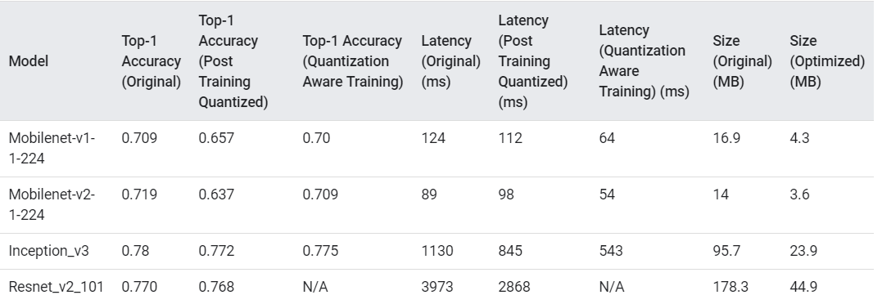
Model Optimization
Quantizing deep neural networks uses techniques that allow for reduced precision representations of weights and, optionally, activations for both storage and computation. Quantization provides several benefits:
Support on existing CPU platforms.
Quantization of activations reduces memory access costs for reading and storing intermediate activations.
TensorFlow Lite provides several levels of support for quantization:
TensorFlow Lite post-training quantization quantizes weights and activations post training easily.
Quantization-aware training allows for training of networks that can be quantized with minimal accuracy drop, this is only available for a subset of convolutional neural network architectures.

Slide 11
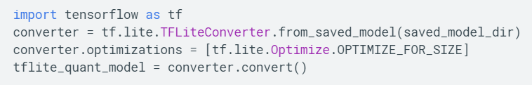
Post-training quantization
Quantizing weights
Full integer quantization of weights and activations
https://www.tensorflow.org/lite/performance/quantization_spec
Model accuracy
It is important to check the accuracy of the quantized model to verify that any degradation in accuracy is within acceptable limits. If the accuracy drop is too high, consider using quantization aware training

Slide 12
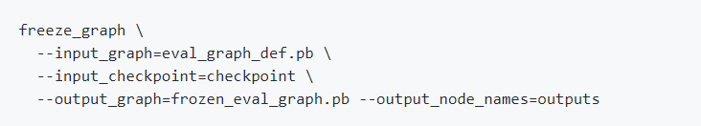
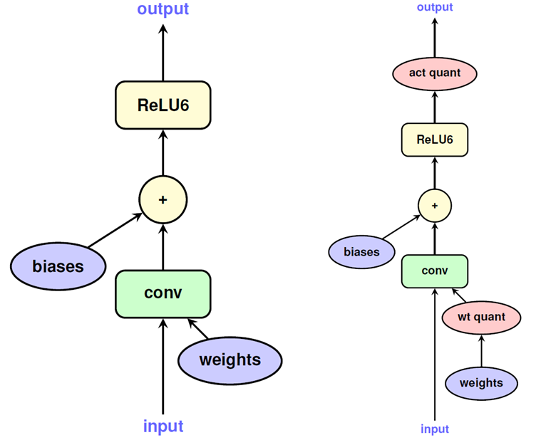
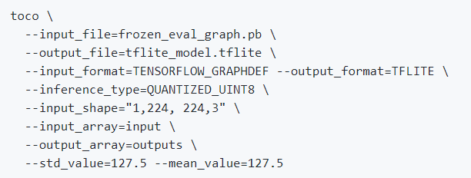
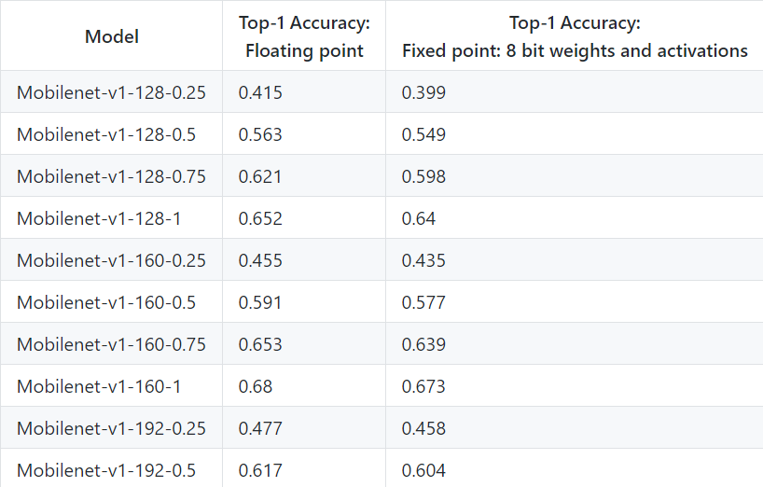
Quantization-aware training - Generating fully-quantized models

Slide 13
Model requirements
Tensor parameters are quantized (8-bit fixed-point numbers)
You must use quantization-aware training (post-training quantization is not supported).
Tensor sizes
They are constant at compile-time (no dynamic sizes)
Model parameters
Such as bias tensors are constant at compile-time
Tensors are either 1-, 2-, or 3-dimensional
If a tensor has more than 3 dimensions, then only the 3 innermost dimensions may have a size greater than 1.
The model uses only the operations supported by the Edge TPU
Logistic, Relu, Tanh, AveragePool2d…etc

Slide 14
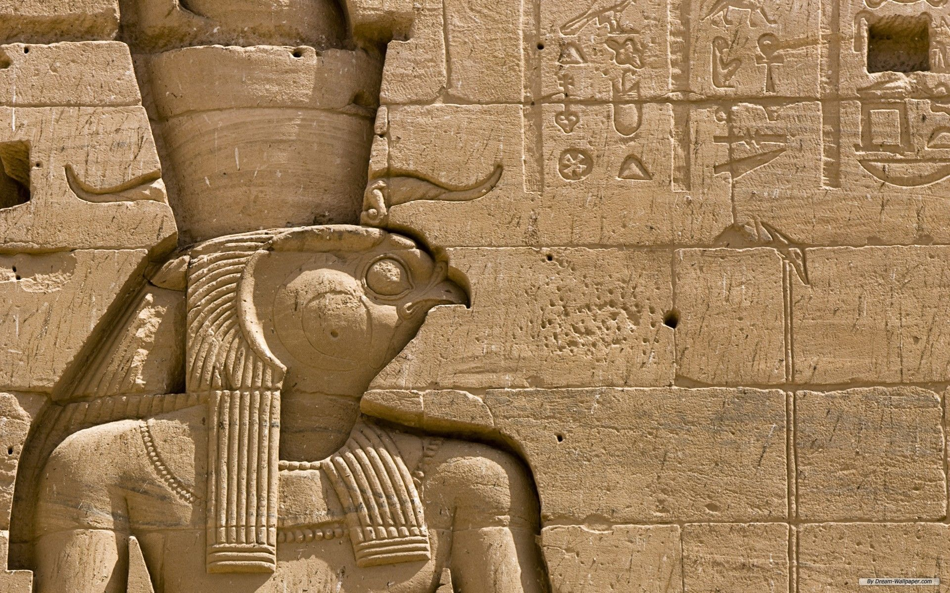
Glyph Detector
Discover the ancients secrets

Slide 15
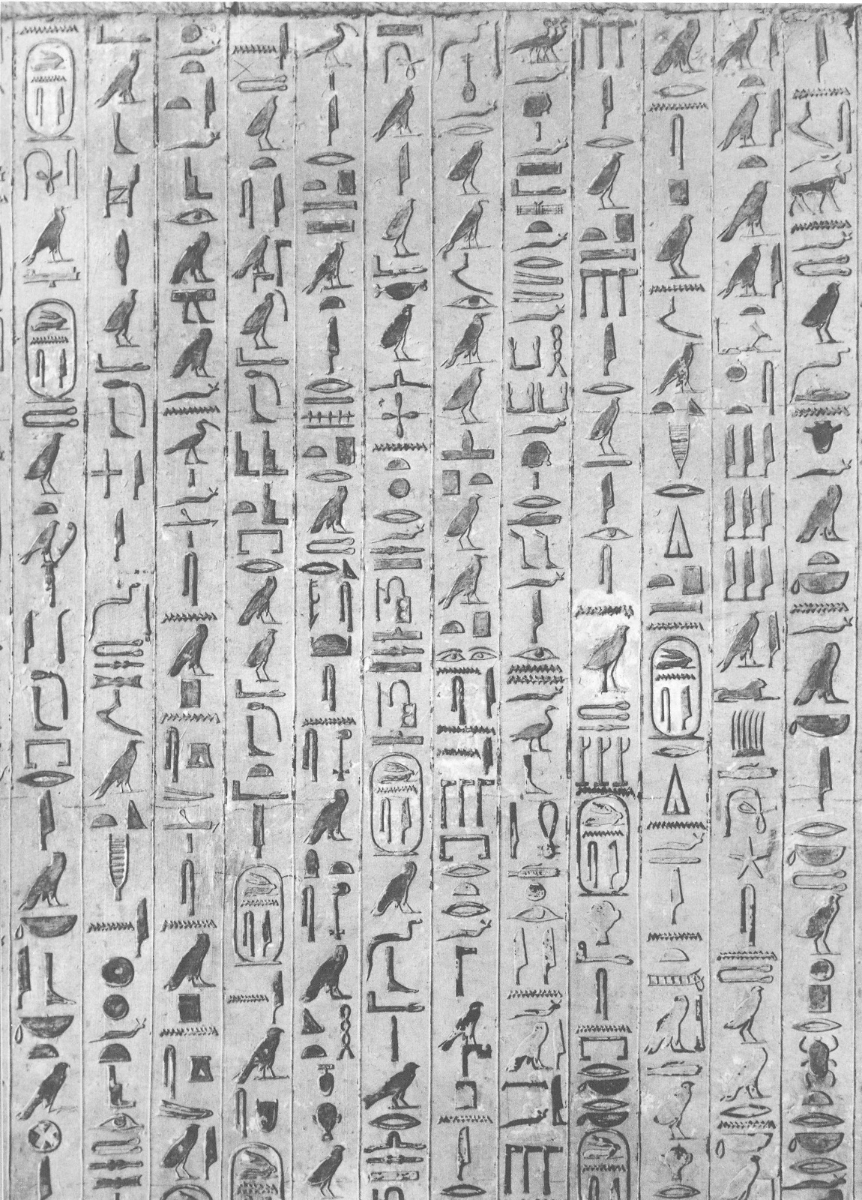

Features & training flow
Dataset
Gardiner List of Egypts Glyphs
In this first development flow, we will have as main tasks, obtaining a dataset such as the Gardiner List. Then the preprocessing of the images of the data set. Extraction of characteristics of the preprocessed images and finally the corresponding training, testing and evaluation.
Preprocess Images
Preprocessing images with resize, crops, ligthning analysis, blur or smootthing…etc
Extract features
With Keras and tensorflow network we extract the features of the preprocesed images and get the correspont labels for each one to package them for the training phase
Training, testing and evaluation

Slide 16
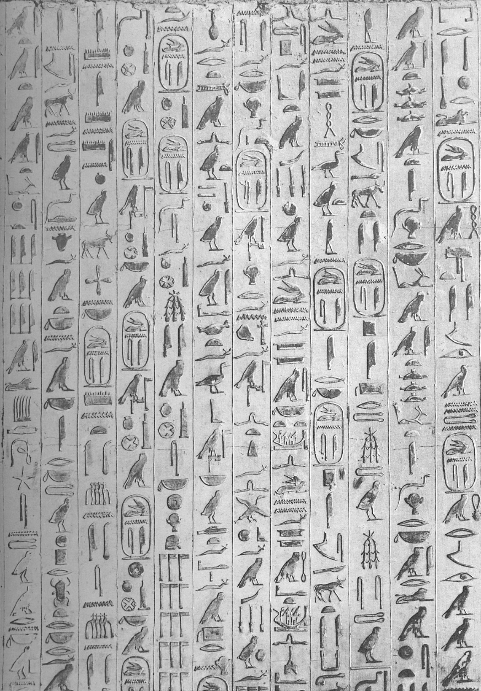
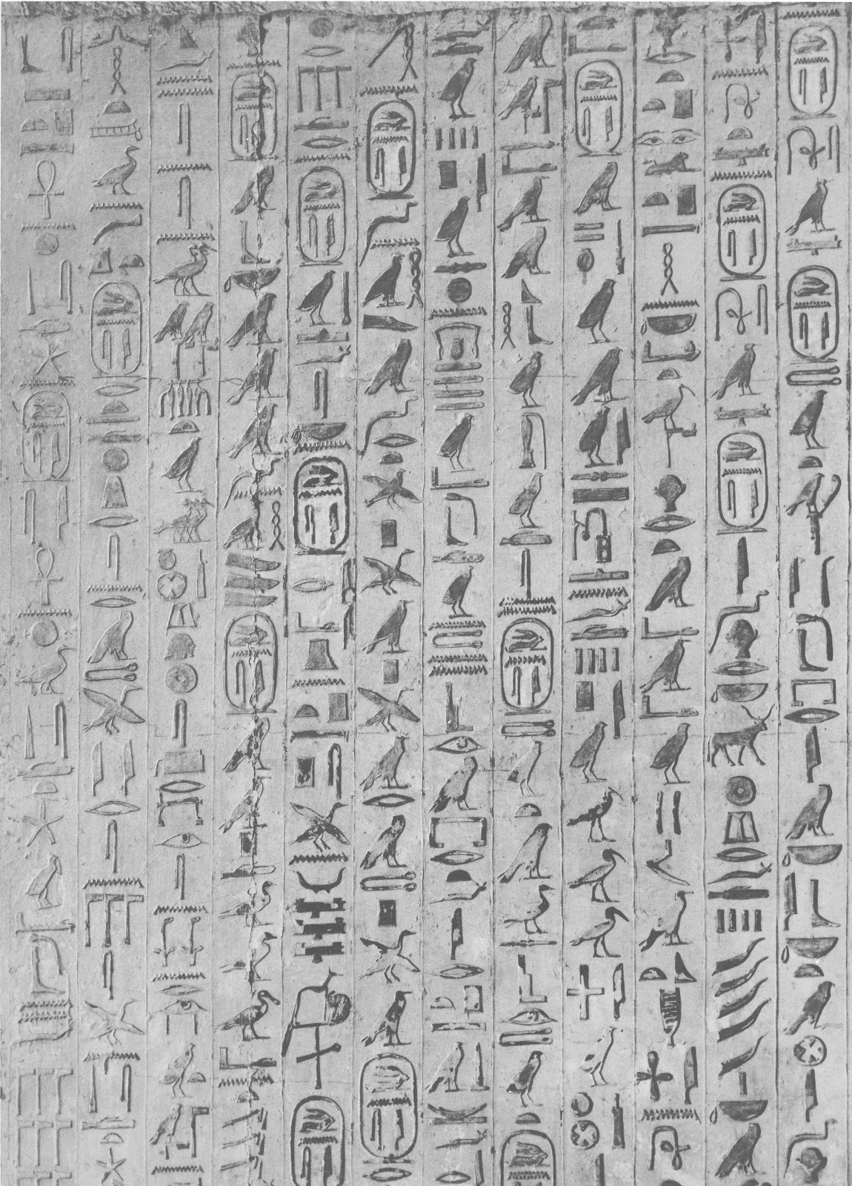
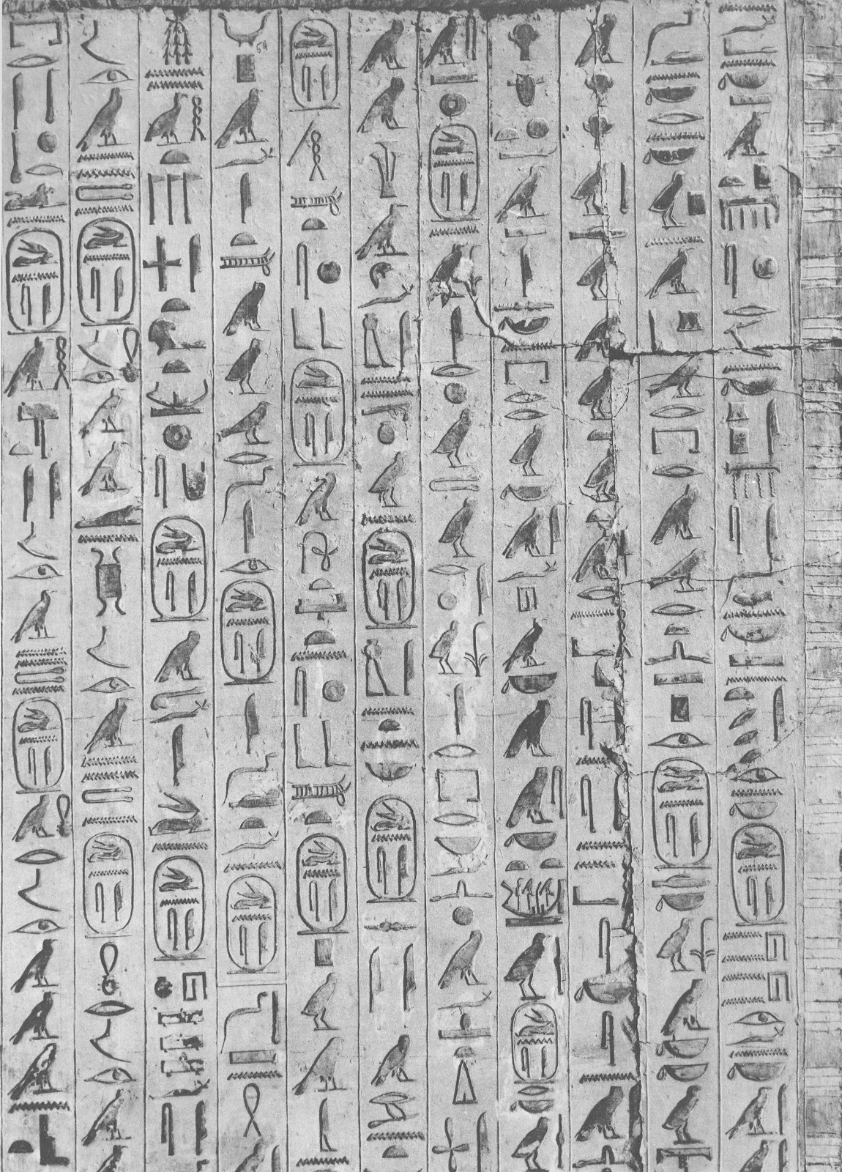
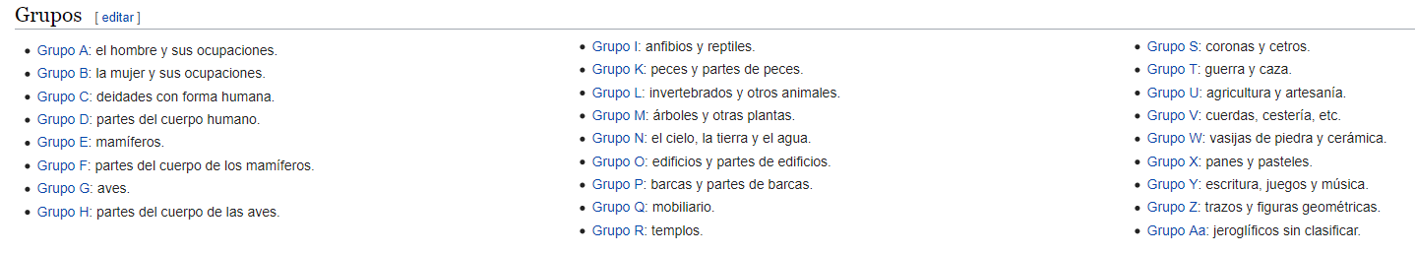
Dataset

Slide 17
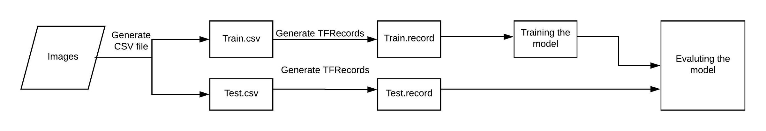



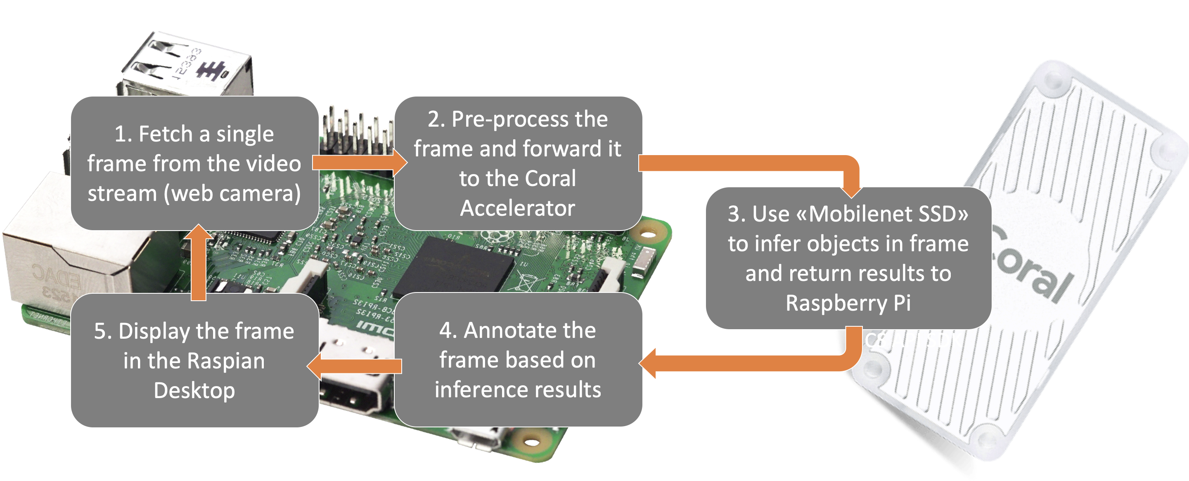
Glyphs Dataset
TPU Compiler

Slide 18
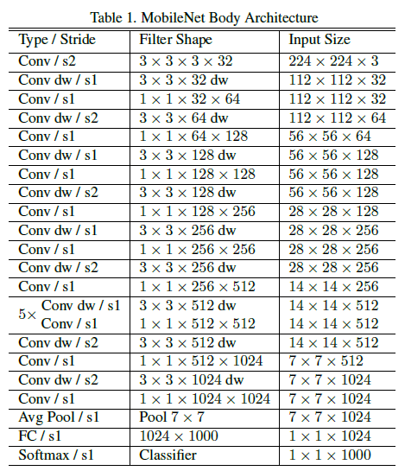
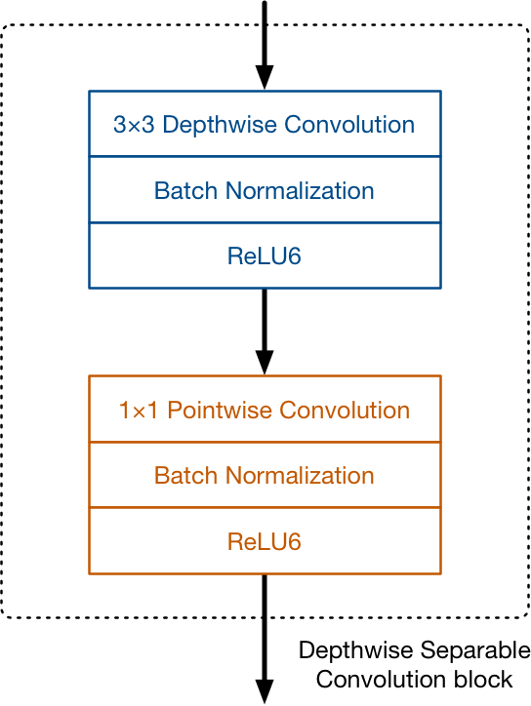
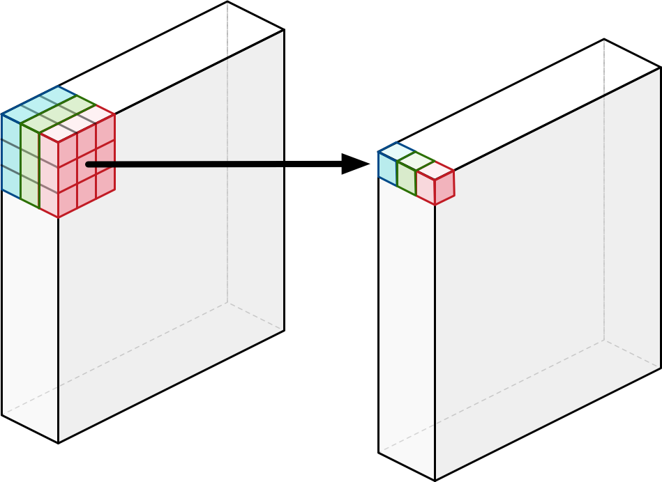
Mobilenet V1 Quantized

Slide 19
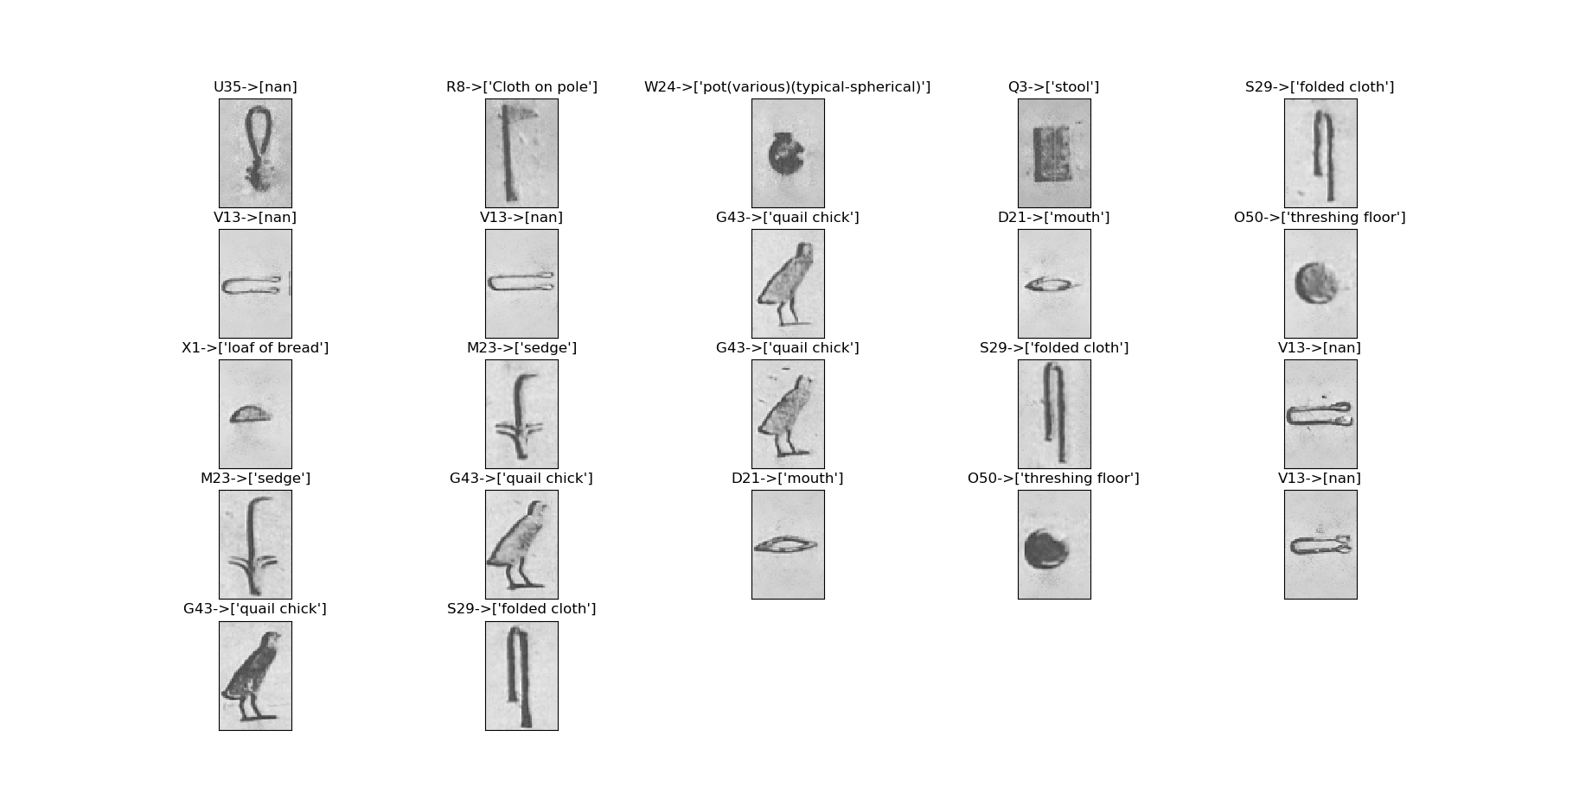

Slide 20
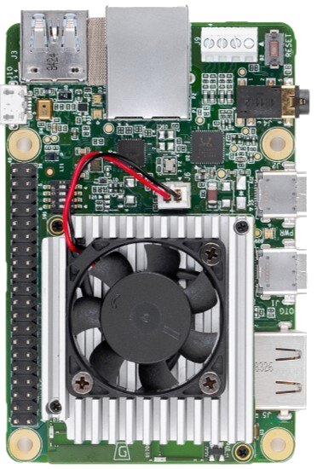
Coral Dev Board

Slide 21
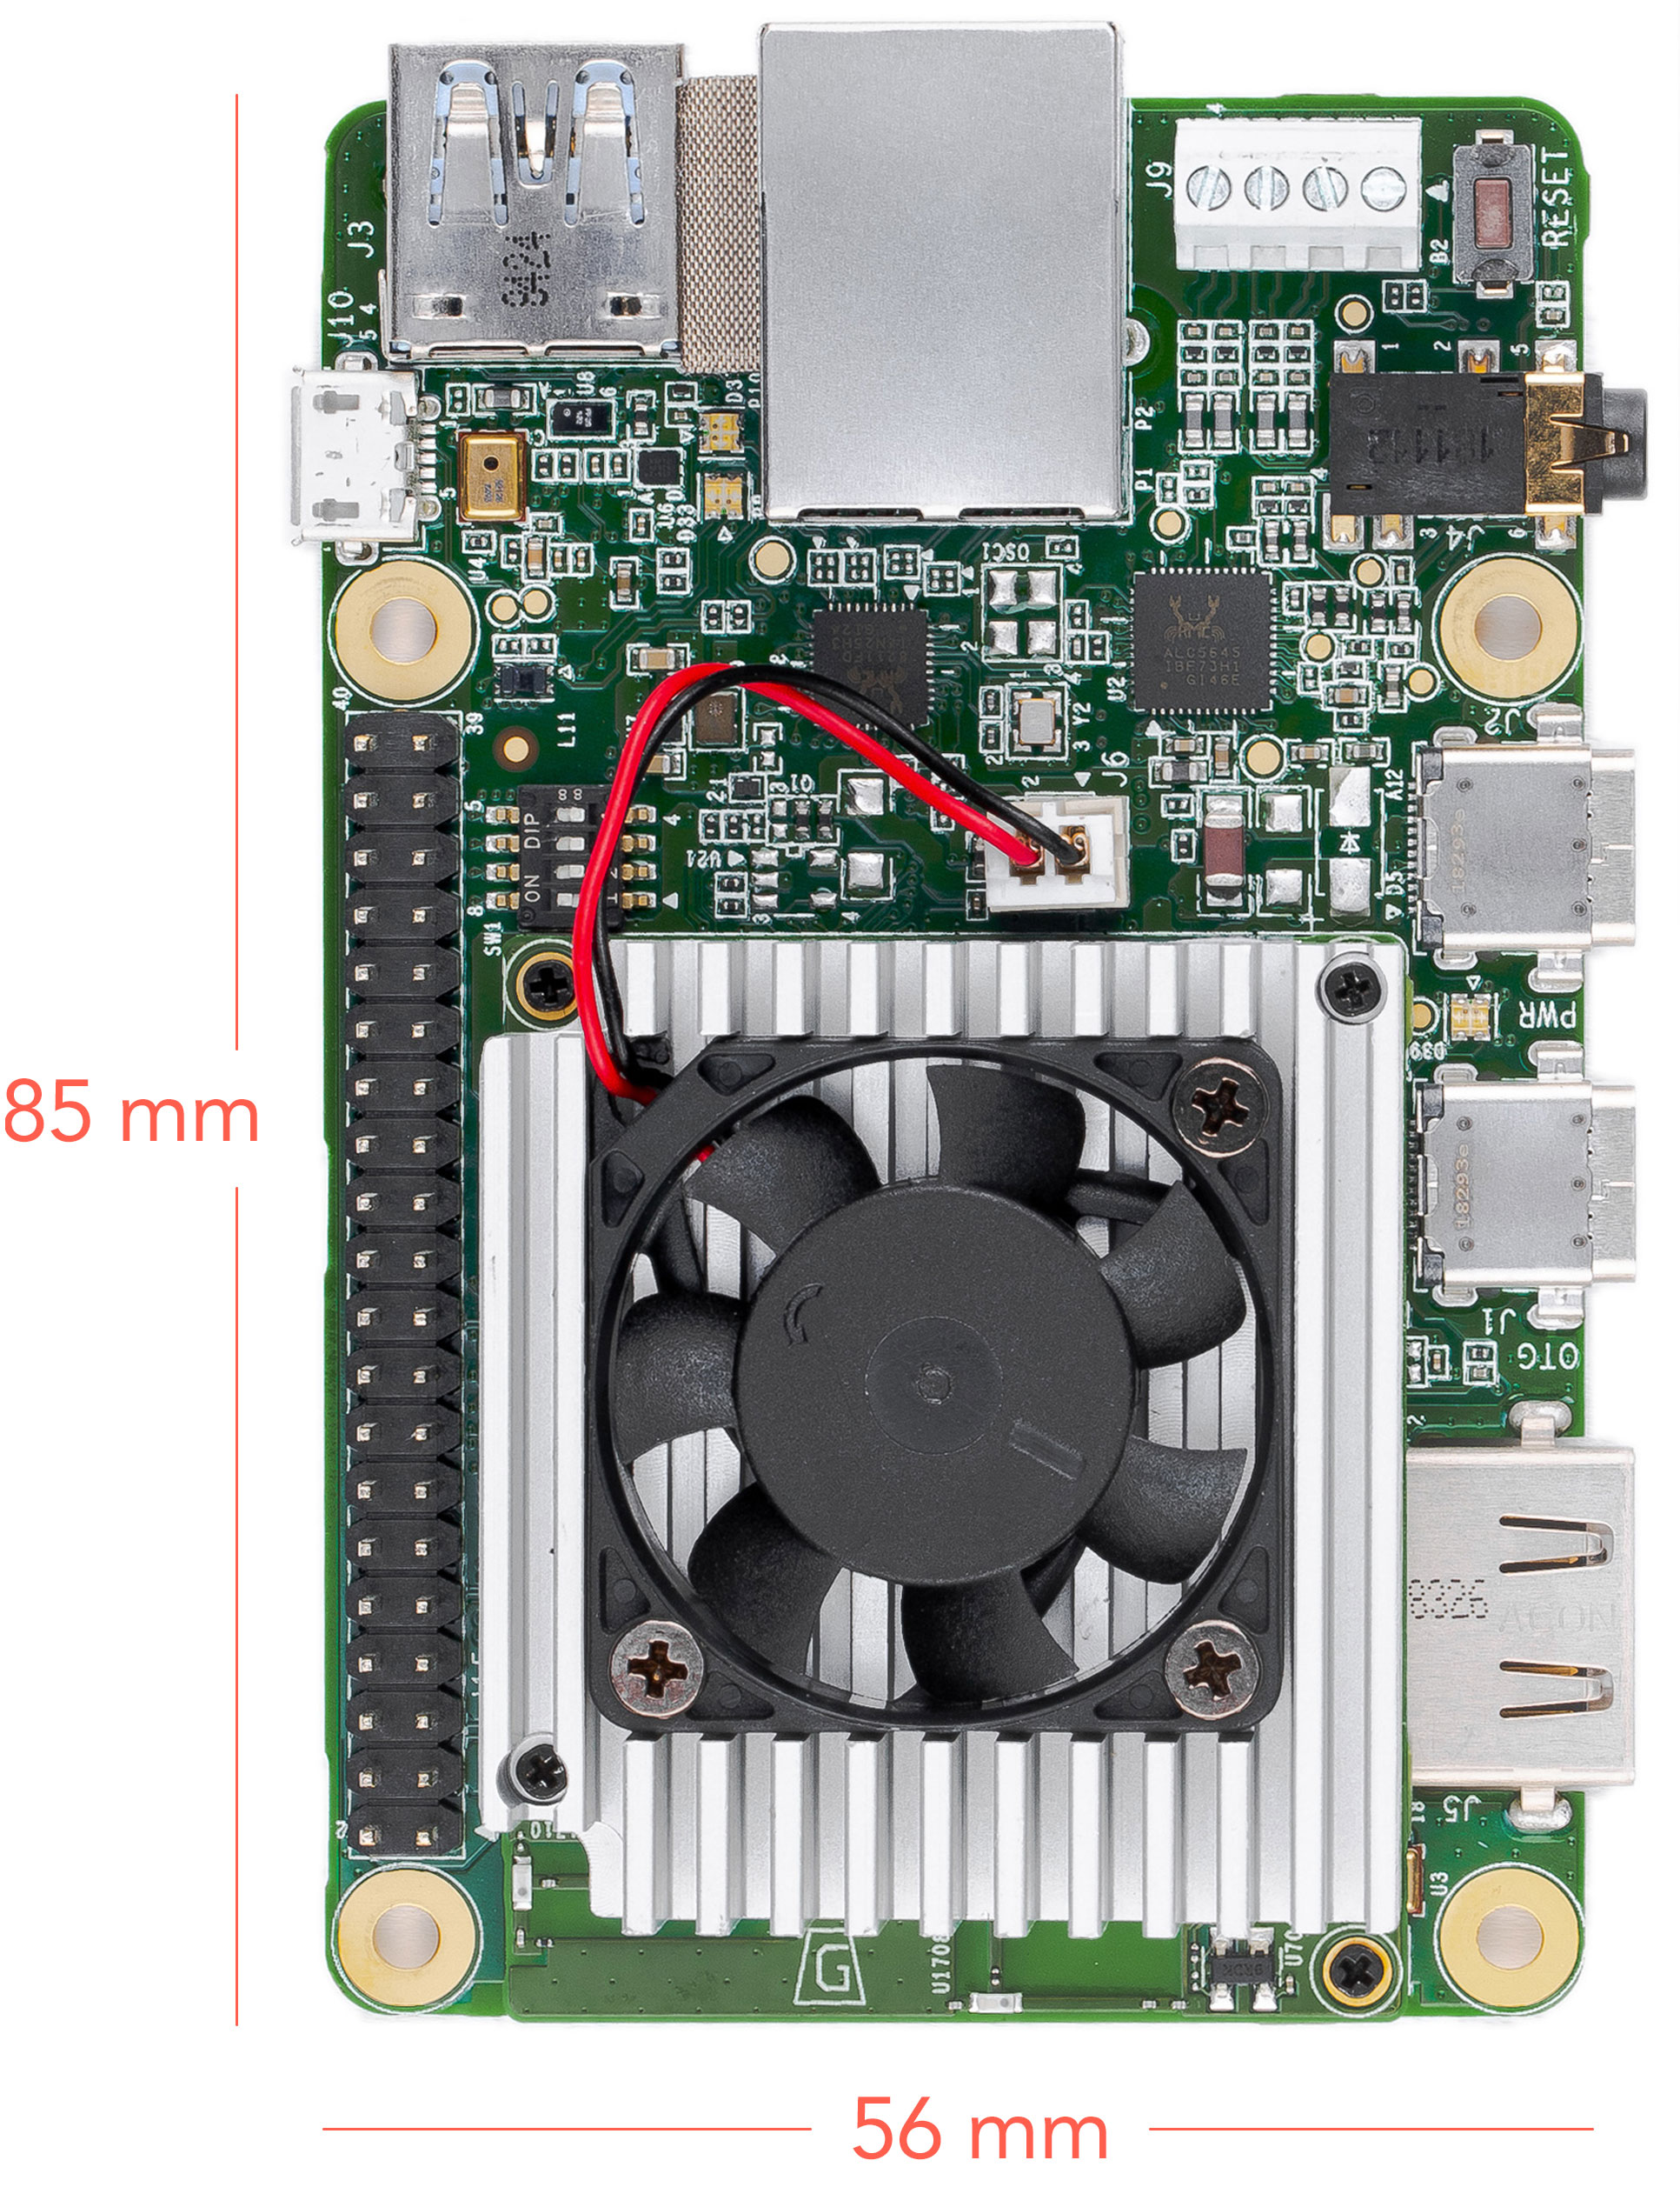
Features
Edge TPU System-on-Module (SoM)
NXP i.MX 8M SoC (Quad-core Cortex-A53, plus Cortex-M4F)
Google Edge TPU ML accelerator coprocessor
Cryptographic coprocessor
Wi-Fi 2x2 MIMO (802.11b/g/n/ac 2.4/5GHz)
Bluetooth 4.1
8GB eMMC
1GB LPDDR4
USB connections
USB Type-C power port (5V DC)
USB 3.0 Type-C OTG port
USB 3.0 Type-A host port
USB 2.0 Micro-B serial console port
Audio connections
3.5mm audio jack (CTIA compliant)
Digital PDM microphone (x2)
2.54mm 4-pin terminal for stereo speakers
Video connections
HDMI 2.0a (full size)
39-pin FFC connector for MIPI DSI display (4-lane)
24-pin FFC connector for MIPI CSI-2 camera (4-lane)
MicroSD card slot
Gigabit Ethernet port
40-pin GPIO expansion header
Supports Mendel Linux (derivative of Debian)

Slide 22

MDT (Mendel Development Tool)
Mendel Development Tool (mdt)
Is a command-line tool that lets you communicate with a device running Mendel Linux
The ”mdt” command facilitates a variety of device actions such as opening a shell, installing Debian packages, pushing and pulling files, and more.

Slide 23
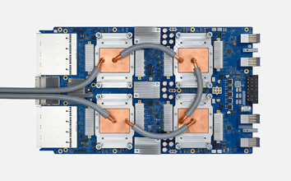
TensorFlow models on the Edge TPU
What is TPU?
Tensor Preprocessor Unit
What is Edge TPU?
Google chip designed to run machine learning (ML) models for edge computing. Google Cloud bring us the possibility to use it.
The Edge TPU can execute deep feed-forward neural networks such as convolutional neural networks (CNN).
It supports only TensorFlow Lite models that are fully 8-bit quantized and then compiled specifically for the Edge TPU.

Slide 24
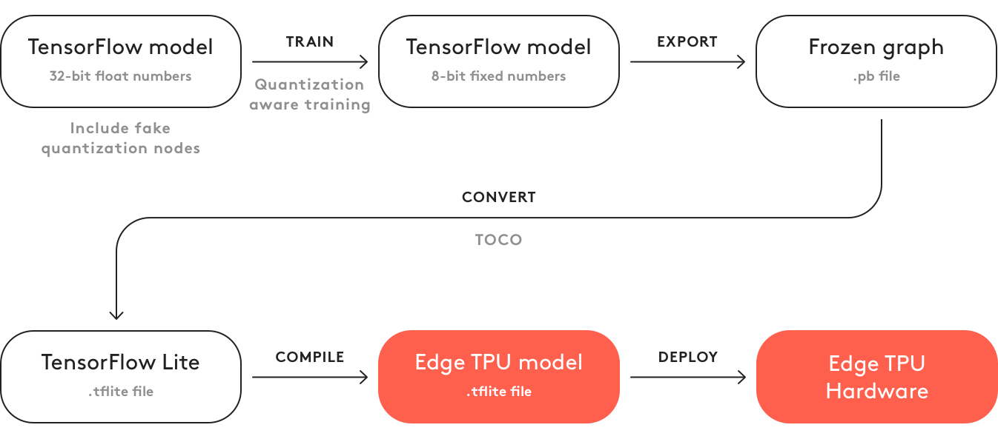
TensorFlow models on the Edge TPU

Slide 25
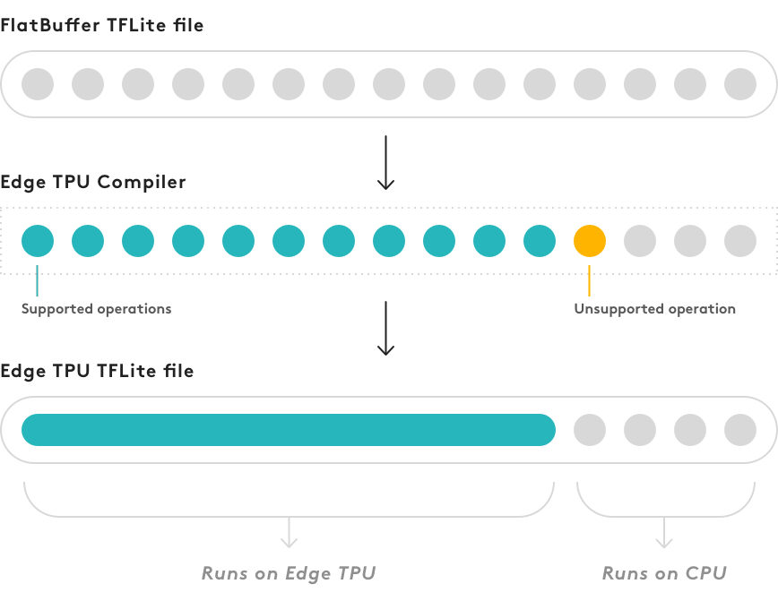

Slide 26
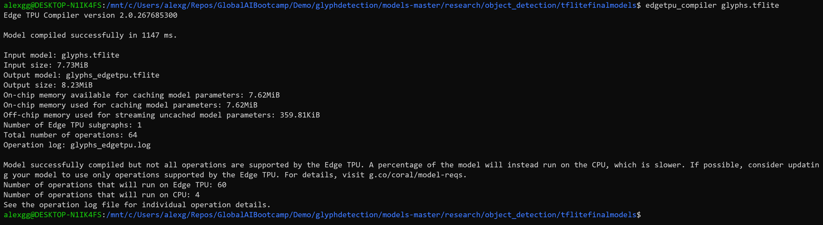
TPU COMPILER

Slide 27
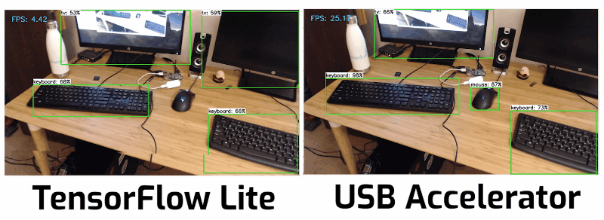

Slide 28
CI/CD Raspberry Pi

Slide 29
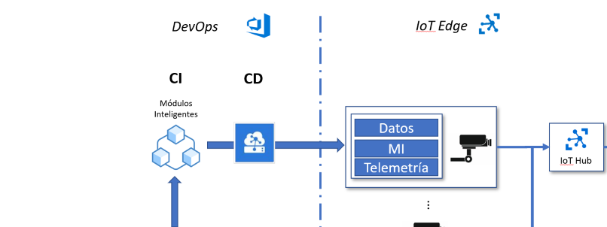
CI/CD

Slide 30
Madrid 13 December 2019

